Slide 1
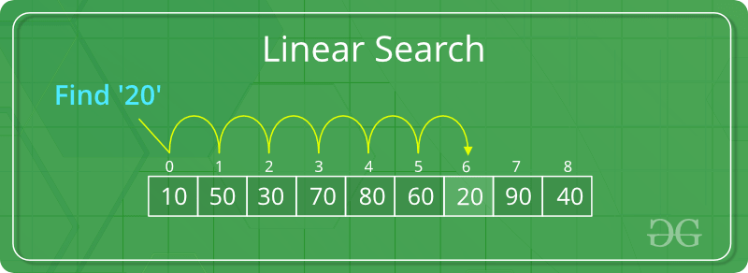
4.3.4 Searching algorithms
Syllabus Details
4.3.4 Searching algorithms
4.3.4.1 Linear search
4.3.4.2 Binary search
4.3.4.3 Binary tree search
4.2.6 Hash tables
4.2.6.1 Hash tables
Preliminary Multiple Choice Questions
Complete the Preliminary Multiple Choice questions posted by the teacher on Teams.
4.3.4.1 Linear Search
Key point
Linear search
Linear search scans each item or element in a collection of items, e.g. playing cards, in turn, starting from the beginning, until a match is found or the end of the collection is reached.
Linear search doesn’t care whether the list is ordered or not.
Watch the video posted on Teams.

Slide 2
Questions
A pack of cards is shuffled to ensure that the cards are in no particular order and then placed face down on a table. Starting from the top of the pack, one playing card is turned over at a time until the Ace of Spades is found.
Part A
If the task was repeated many times, shuffling the pack of 52 cards before each new search, on average how many cards would need to be turned over to find the Ace of Spades?
Part B
What is the maximum number of cards that need turning over to find a match?
Part C
Half of the pack is removed. Starting from the top of the pack, one playing card is turned over at a time until either the Ace of Spades is found or all the cards have been examined.
What is the maximum number of cards that need turning over to find the Ace of Spades or to discover that the half pack doesn’t contain the Ace of Spades?
Key concept
Search length
Search length = no of elements of the array or list which are examined before a match is found.

Slide 3
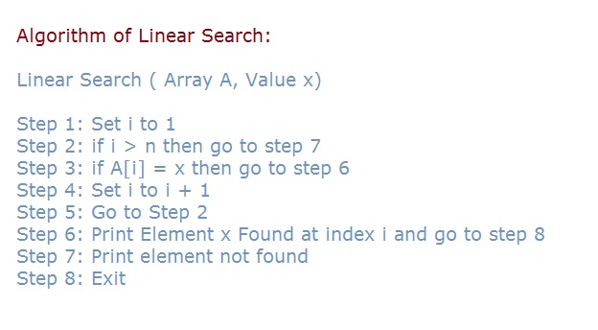
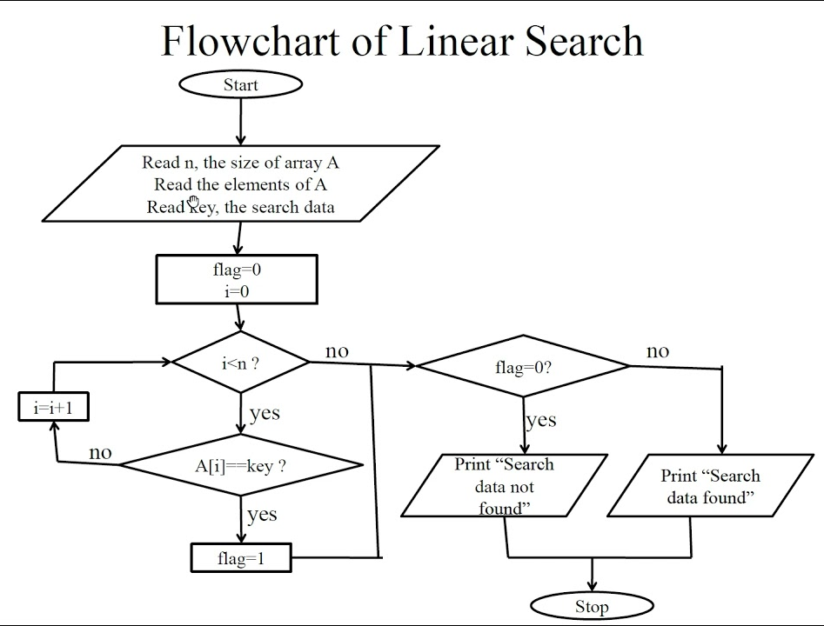
Algorithm for linear search
Examples of the algorithm in different forms

Slide 4
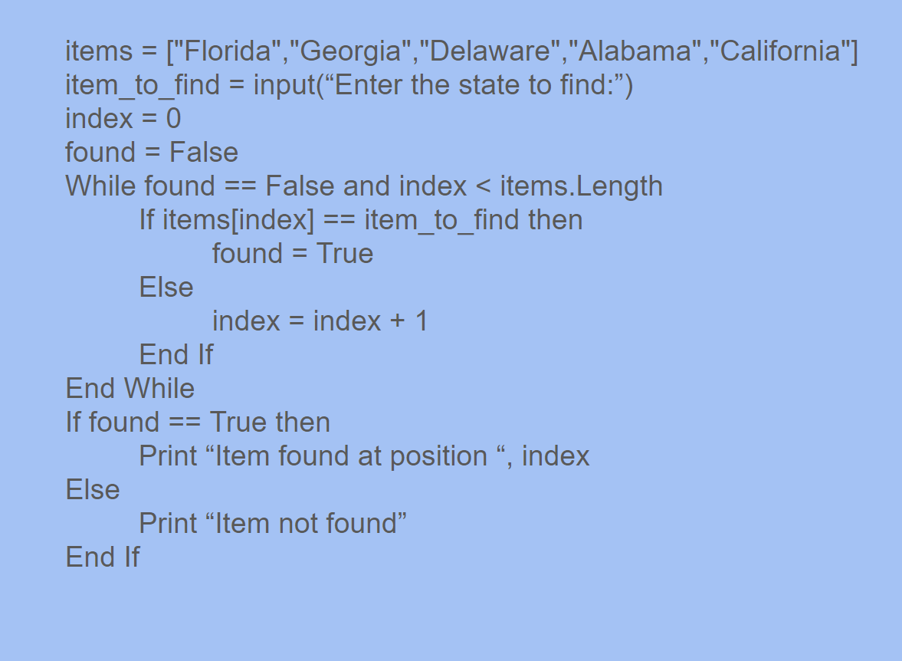
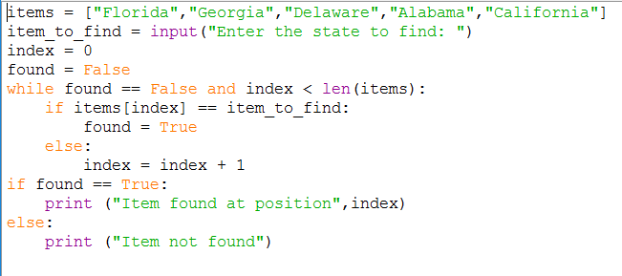
Algorithm for linear search
Pseudocode example using a list.
Python code for the above example.

Slide 5
Algorithm for linear search
Task
Work out the time complexity for the algorithm below. Do it for best, average and worst scenario. To help you complete the step through table on the next page.
Best case = O(1)
Average Case = O(n/2) -> inf = O(n)
Worst Case = O(n)

Slide 6
Algorithm for linear search
Task
Index | 0 | 1 | 2 | 3 | 4
Step 1
 | Florida | Georgia | Delaware | Alabama | California
Step 2
 | Florida | Georgia | Delaware | Alabama | California
Step 3
 | Florida | Georgia | Delaware | Alabama | California
Step 4
 | Florida | Georgia | Delaware | Alabama | California
Step 5 | Found California
 | Florida | Georgia | Delaware | Alabama | California
Support
PGonline - Section 8 p 235 LMC - Paper 1 theory p159
Real Python Video 1 Mr BrownCS Video 1

Slide 7
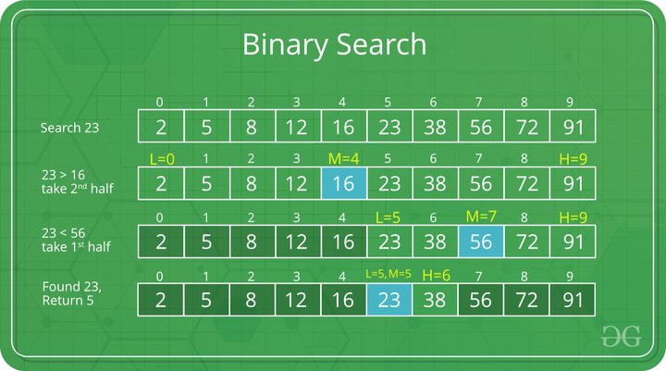
4.3.4.2 Binary Search
Key point
Binary search
Binary search uses a “divide and conquer” approach to search a list, chopping the list into smaller and smaller lists to search until the item is found or the list cannot be divided anymore.
A binary search can only be done on a sorted list. It is best on a large data set.
Watch the video posted on Teams.

Slide 8
Worked example
You are searching for the word “pig”.
boy | car | cat | day | dog | man | pen | pig | red
boy | car | cat | day | dog | man | pen | pig | red
boy | car | cat | day | dog | man | pen | pig | red
boy | car | cat | day | dog | man | pen | pig | red
boy | car | cat | day | dog | man | pen | pig | red

Slide 9
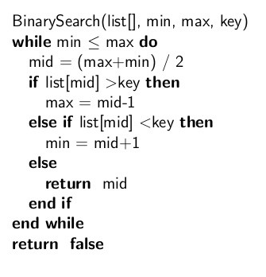
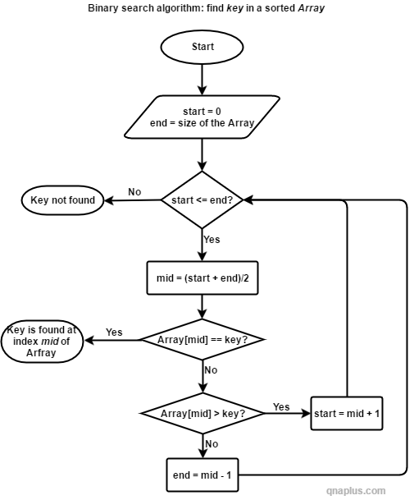
Algorithm for binary search
Examples of the algorithm in different forms

Slide 10
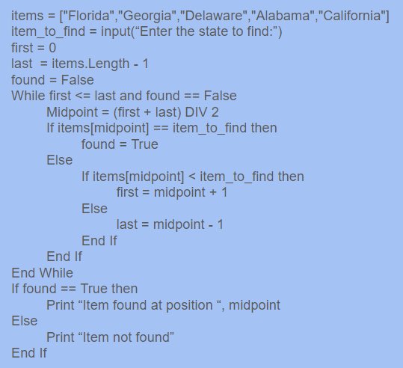
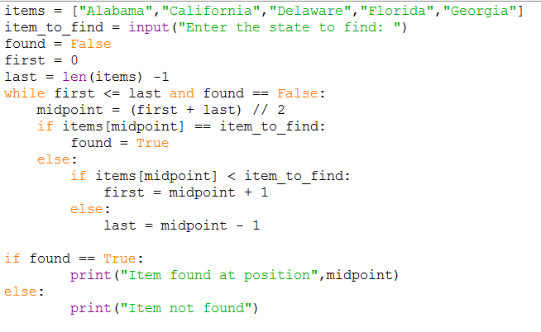
Algorithm for binary search
Pseudocode example using a list.
Python code for the above example.

Slide 11
Algorithm for binary search
Task
Work out the time complexity for the algorithm below. Do it for best, average and worst scenario. To help you complete the step through table on the next page.
Best = O(1)
Average = log₂(n)
Worst = log₂(n)

Slide 12
Algorithm for binary search
Task
Index | 0 | 1 | 2 | 3 | 4
Step 1
 | Alabama | California | Delaware | Florida | Georgia
Step 2
 | Alabama | California | Delaware | Florida | Georgia
Step 3
 | Alabama | California | Delaware | Florida | Georgia
Step 4
 | Alabama | California | Delaware | Florida | Georgia
Step 5
 | Alabama | California | Delaware | Florida | Georgia

Slide 13
Comparing linear and binary search algorithms
No. of items in list | Max search length binary search | Maximum search length linear search
1 | 1 | 1
2 | 2 | 2
4 | 3 | 4
8 | 4 | 8
16 | 5 | 16
32768 | 16 | 32768
65536 | 17 | 65536
16777216 | 25 | 16777216

Slide 14
Comparing linear and binary search algorithms
Question
A stall is planned for a school fete which is expected to make some money for the school by challenging visitors to guess a secret number between 1 to 1000000 within 20 guesses. After each guess, one of the following answers to the guess is supplied by the stall holder:
Too Low, Too High, or You Win.
Each visitor is charged £1 to have a go and the prize for guessing correctly is £10.
Do you think that this stall will make a profit? Explain the reasoning you used to reach your conclusion.
By using a binary search it is possible for the player to win the prize within the 20 guesses
Check your understanding
Attempt the multiple choice questions posted on Teams.

Slide 15
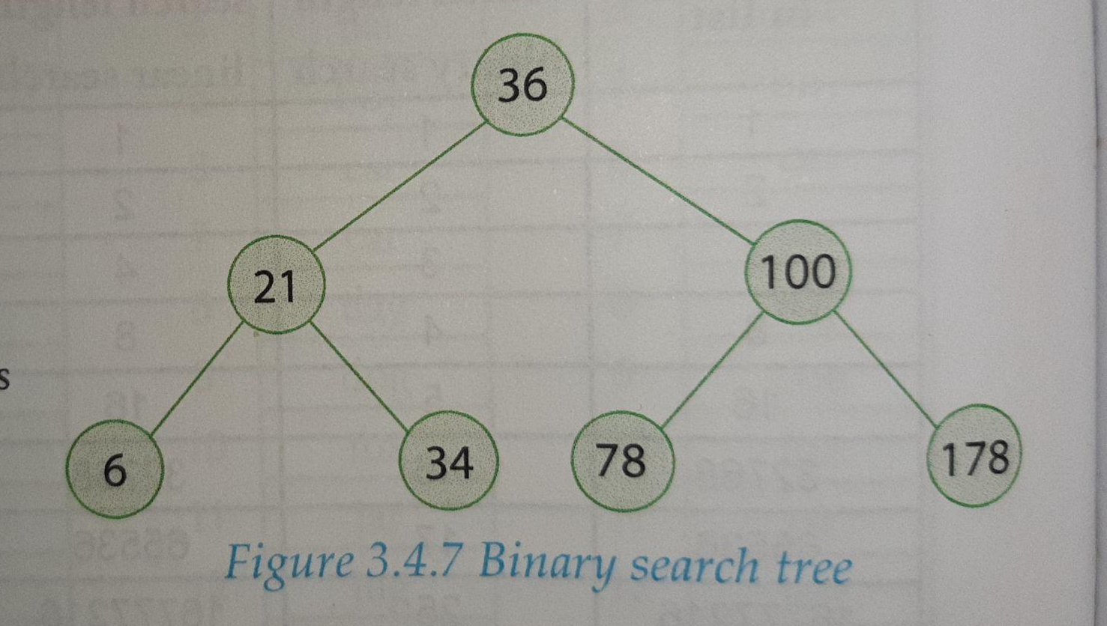
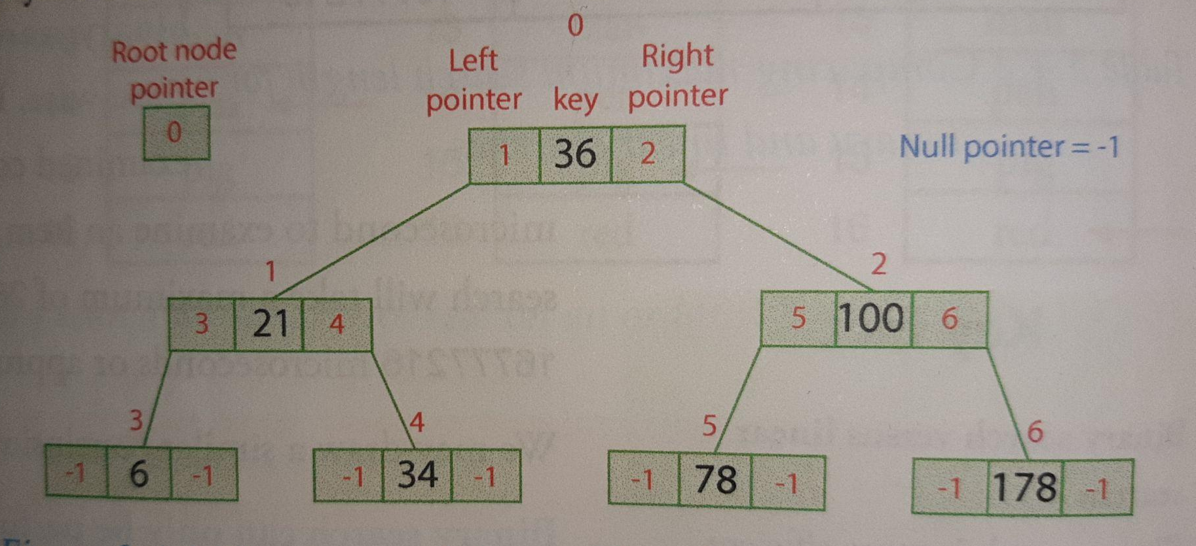
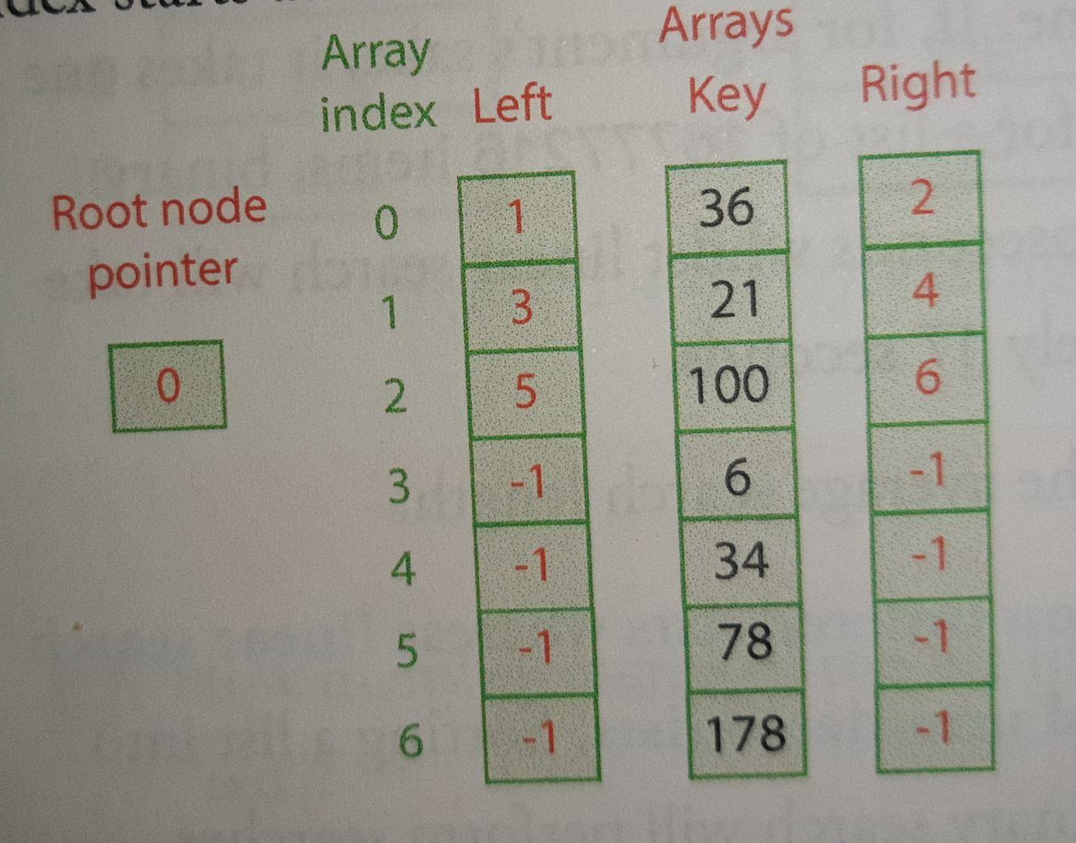
4.3.4.3 Binary tree search
Key Concept
A binary tree is shown below. The nodes of the tree are ordered so that all the integers in the nodes in the left sub-tree are smaller than the integer in the root and all the integers in the nodes in the right sub-tree are greater than the root.
The two diagrams below show how this binary search tree may be stored in three dimensional arrays.

Slide 16
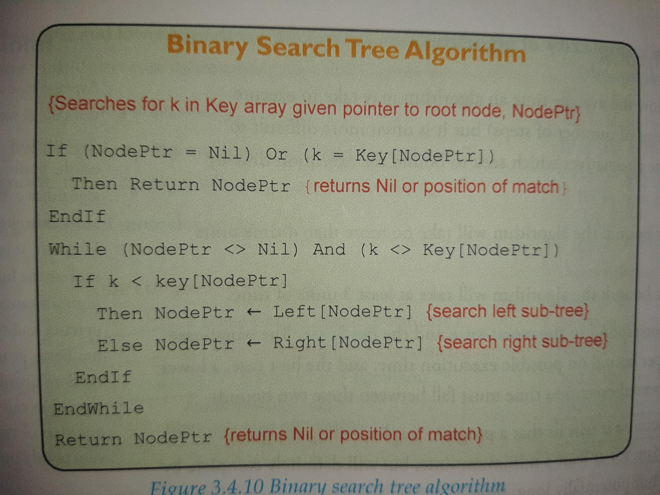
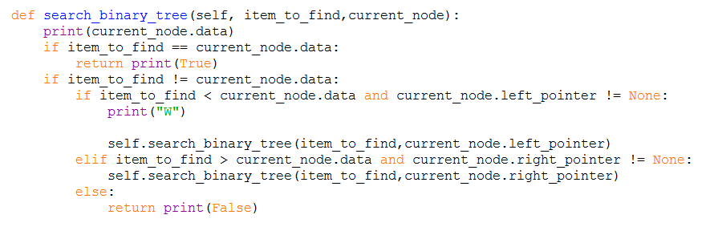
Algorithm for binary search

Slide 17
Algorithm for binary search tree
Questions
Hand trace the binary search tree algorithm given on the previous page by searching for the value 34 in the binary search tree shown on page 15.
Complete the table below.
Hand trace the binary search tree algorithm given on the previous page by searching for the value 85 in the binary search tree shown on page 15.
Time-complexity of the binary search tree
k | NodePtr | Key[NodePtr]
34 | 0 | 36
34 | 1 | 21
35 | 4 | 34
k | NodePtr | Key[NodePtr]
85 | 0 | 36
85 | 2 | 100
85 | 5 | 78
85 | -1

Slide 18
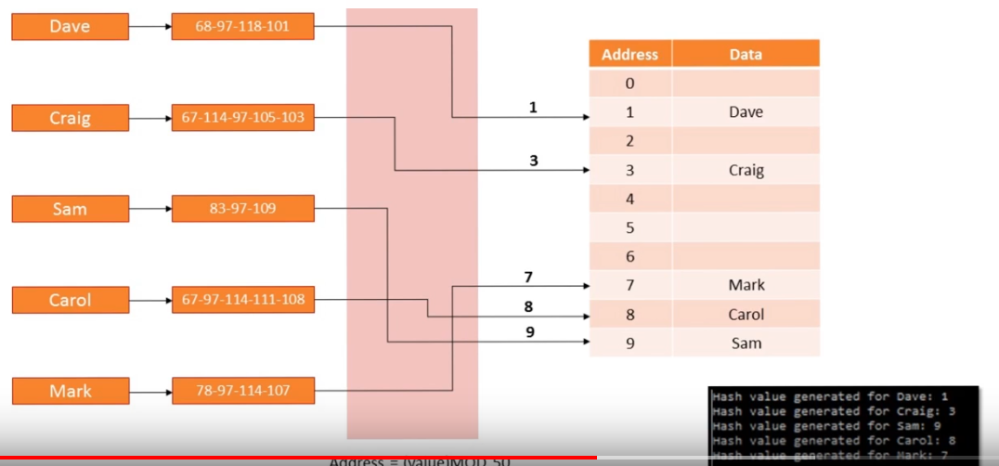
4.2.6.1 Hash tables
Worked Example
Below is a table for a student record.
Limitations of this type of table and table access
A problem surfaces with the operations of searching, inserting and deleting described above when the table contains a large number of records. EG 10000
It just takes too much of the computer’s time to perform these operations. One solution is to use a hash table based on a well-chosen has function.
Hash table
A hash table resembles an ordinary table as described above but differs in the method used to access the rows of the table.
A row of a hash table is accessed directly when looking up, inserting and deleting a record i.e. it does not start from row 0 every time but instead goes directly to the required row. Movement of records when deleting a record is also eliminated.
Index | ULN | Forname | Surname
0 | 34567890 | Fred | Bloggs
1 | 90002789 | Mary | Smth
2 | 74432167 | Ahmed | Khan
Index | ULN | Forname | Surname
0
1 | 34567890 | Fred | Bloggs
2 | 90002789 | Mary | Smth
3
4 | 74432167 | Ahmed | Khan

Slide 19
4.2.6.1 Hash tables
Worked Example
The table gets the name hash because of the method used to generate the address or row number. A randomising function call a hash function is applied to the record’s key, in this case the 8-digit unique learner number or ULN to map the possible 8-digit ULN values into a much smaller range of values, the possible row numbers. This process is known as hashing.
Hash function
the hash function takes as input the record’s key (hash key) and the outputs the row address of the row for this record.
One example is H (ULN) = ULN Mod 7
ULN | H (ULN)
90002789 | 2
74432167 | 5
Question
Calculate the value of H(ULN) of the following:
31258745 62517493 49981627
0
3
3

Slide 20
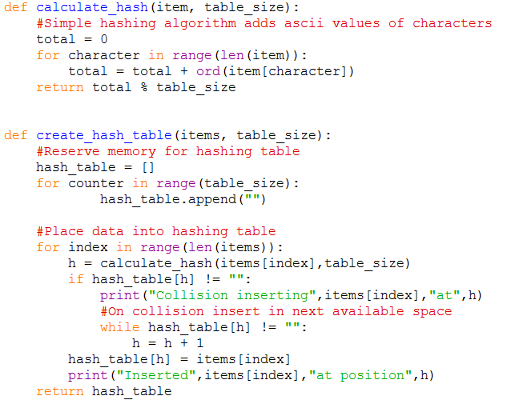
4.2.6.1 Hash tables
Worked Example

Slide 21
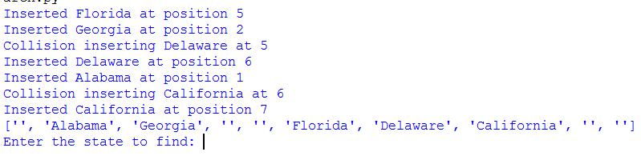
4.2.6.1 Hash tables
Worked Example
What is a collision?

Slide 22
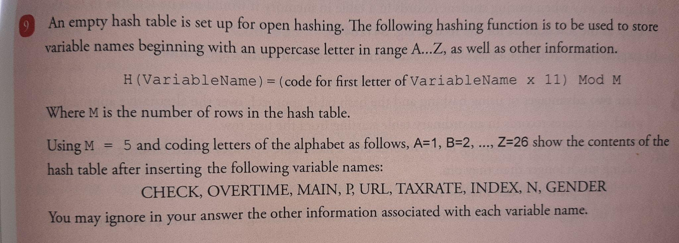
4.2.6.1 Hash tables
Questions

Slide 23
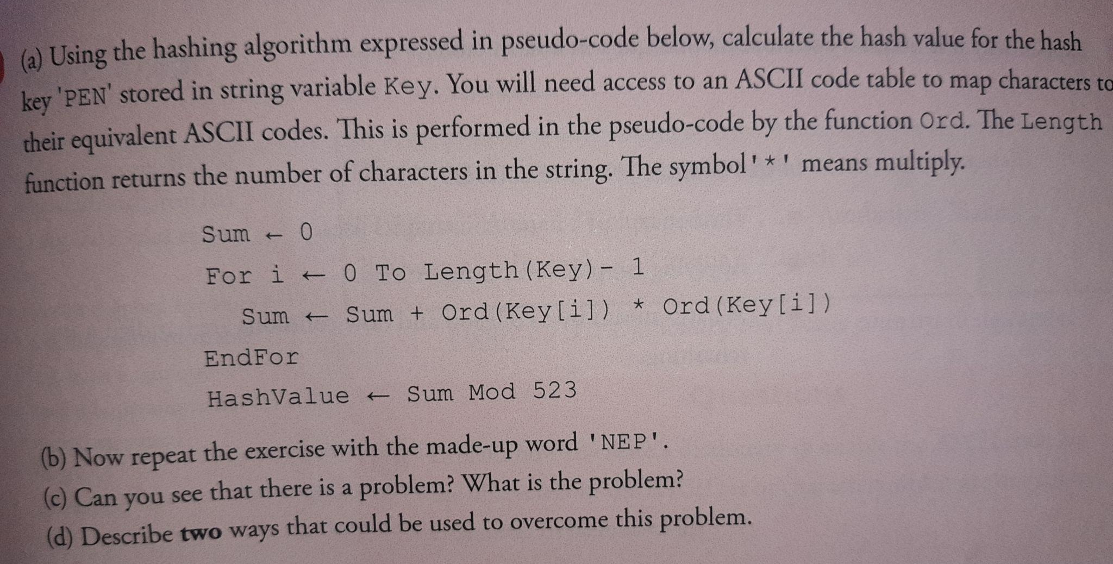
4.2.6.1 Hash tables
Questions

Slide 24
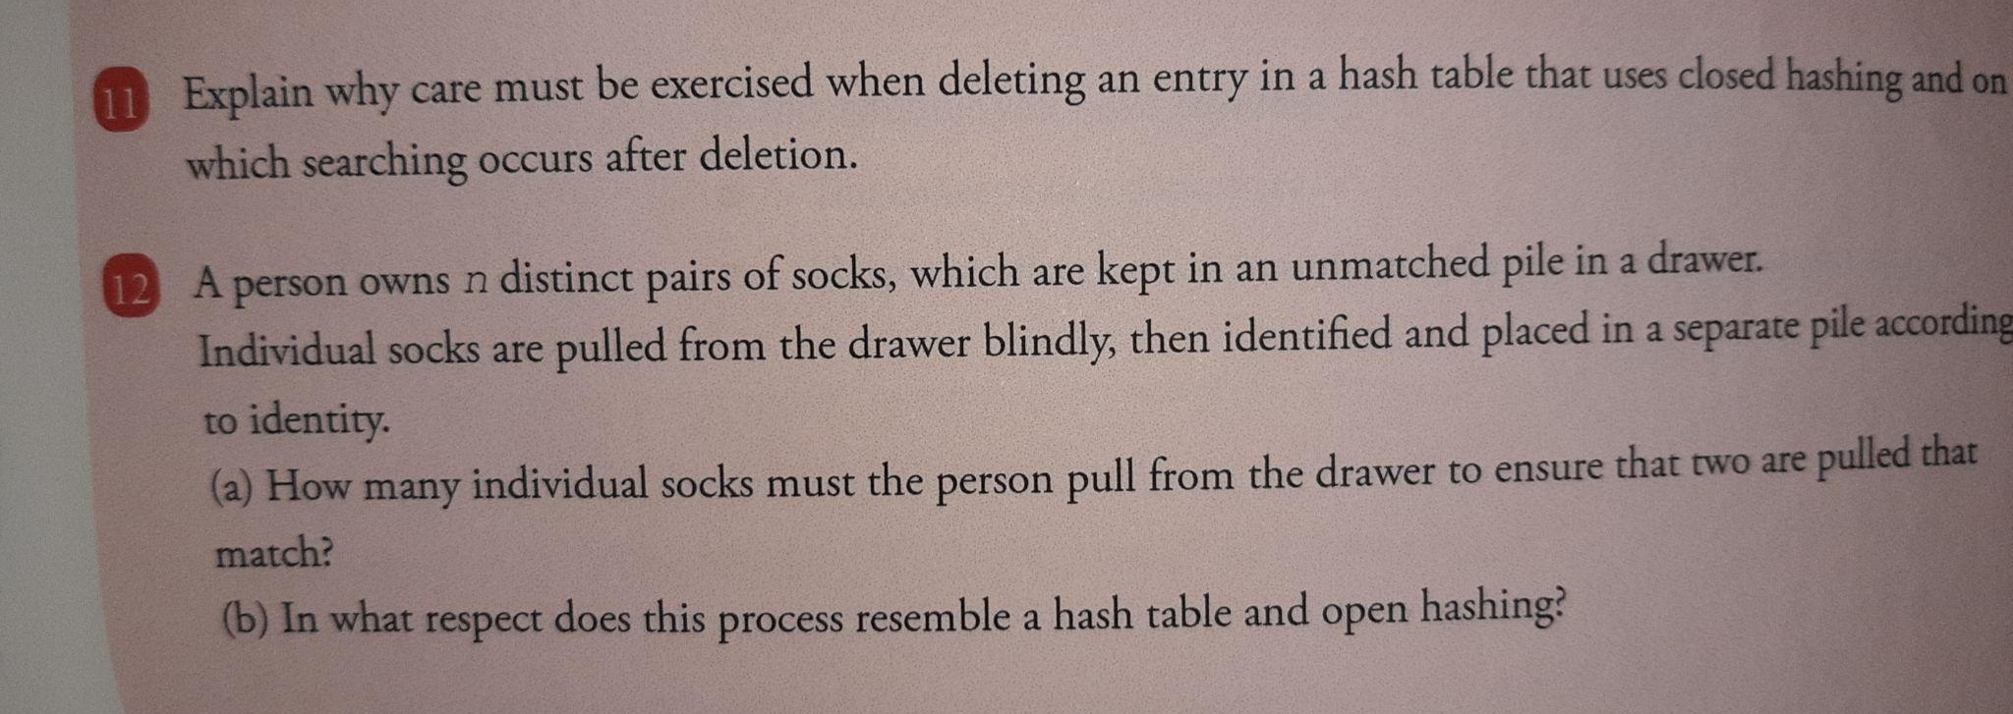
4.2.6.1 Hash tables
Questions

Slide 25
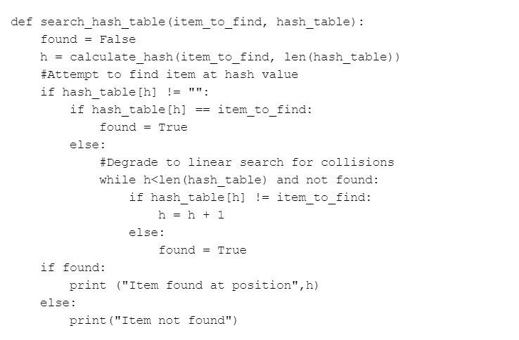
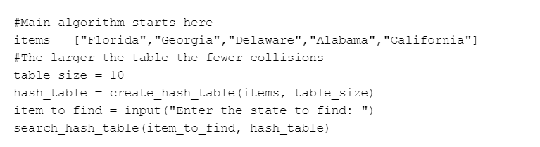
4.2.6.1 Hash table Search
Code for Hash Search
Main program code

Slide 26
Vocabulary
Term | Description

Slide 27
Vocabulary
Term | Description

Slide 28
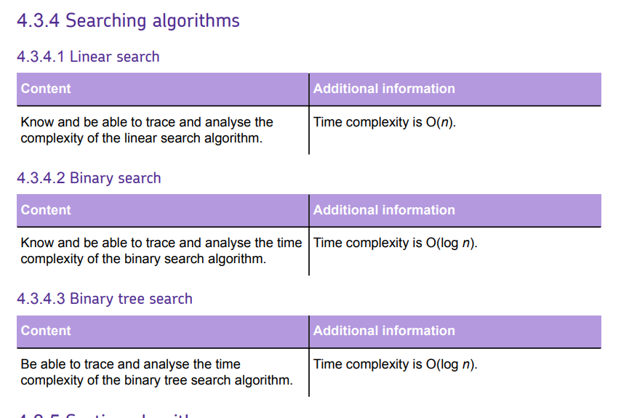

Slide 29




Useful links
Video 1 - Craig N Dave Linear Search Youtube video
Video 2 - Craig N Dave Binary Search Youtube video
Video 3 - Mr J Online Searching Algorithm Youtube video
Website 1 - Isaac Computer Science website - section on searching algorithms
Video 1 | Video 2 | Video 3 | Website 1
Action Plan

